Slide 1
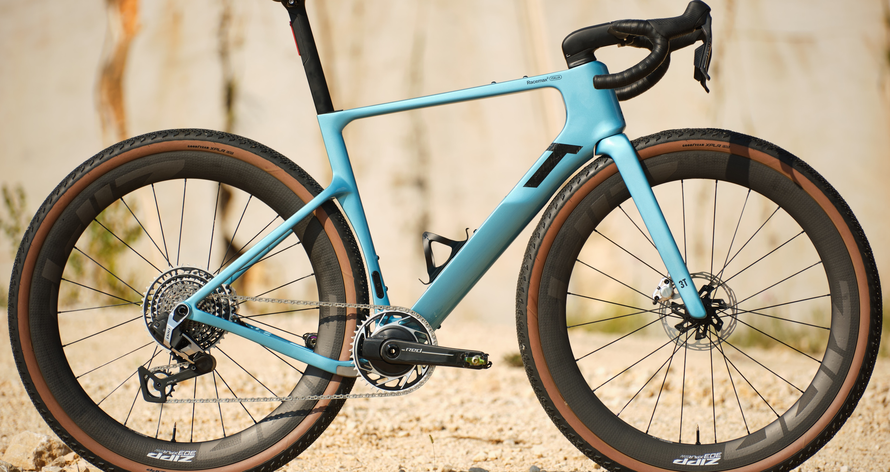

3T.BIKE
PRIMO - 1

Slide 2

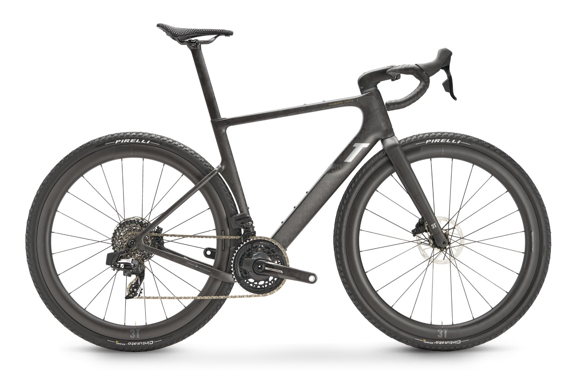
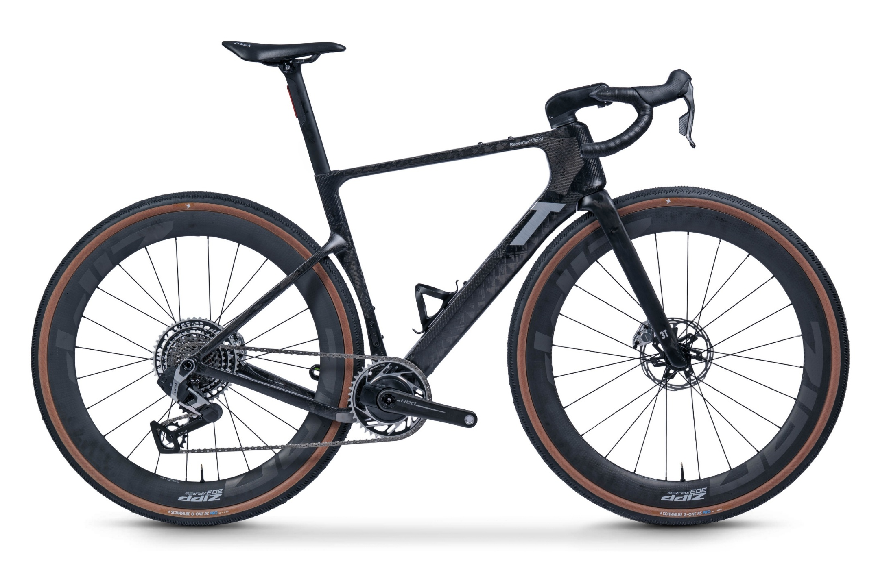
3T’s fastest bike ever for gravel racing and mixed terrain riding.
Developed from the iconic Racemax Italia, every feature has been refined and elevated.
Racemax Italia
Racemax² Italia
Embargo until October 10th, 2025
RACEMAX - 2
Notes:
completely re-engineered frame for an even better all-round experience: faster, more responsive, more agile yet more stable, with improved comfort and refined design. Added to this is the next level of integration

Slide 3
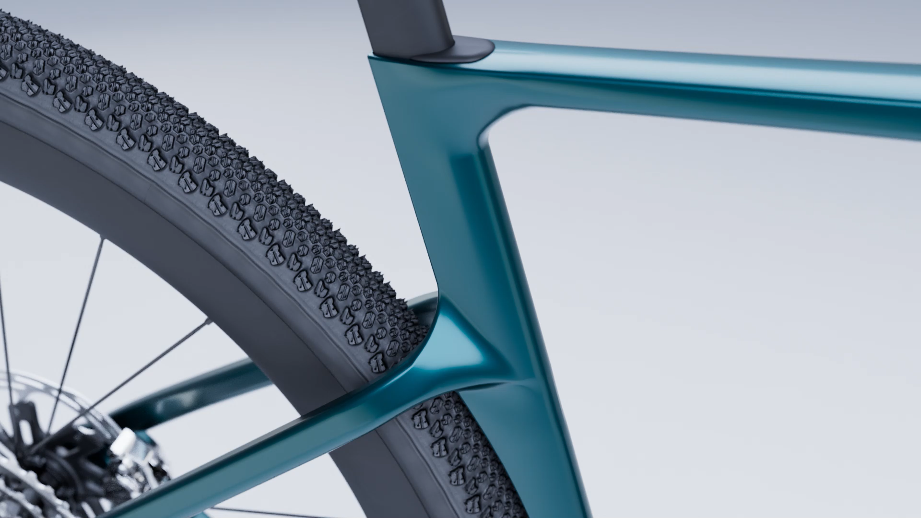
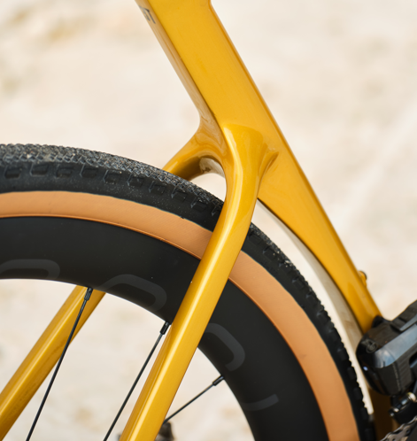
TIRES
DESIGNED AROUND
41-51 mm WAM tires
1X GROUPSETS
up to
51mm WAM
363 mm RAM
2X GROUPSETS
up to 48mm WAM
3T.BIKE
Embargo until October 10th, 2025
RACEMAX - 3
Notes:
[no SRAM compatibility]

Slide 4
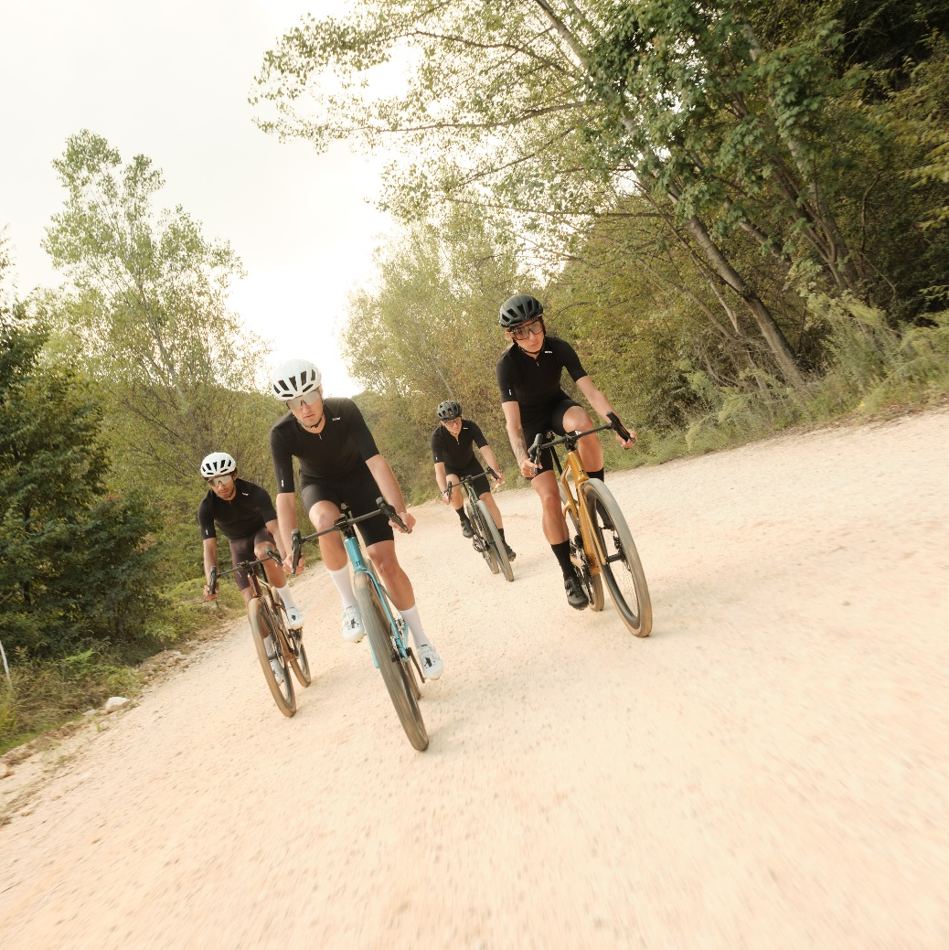
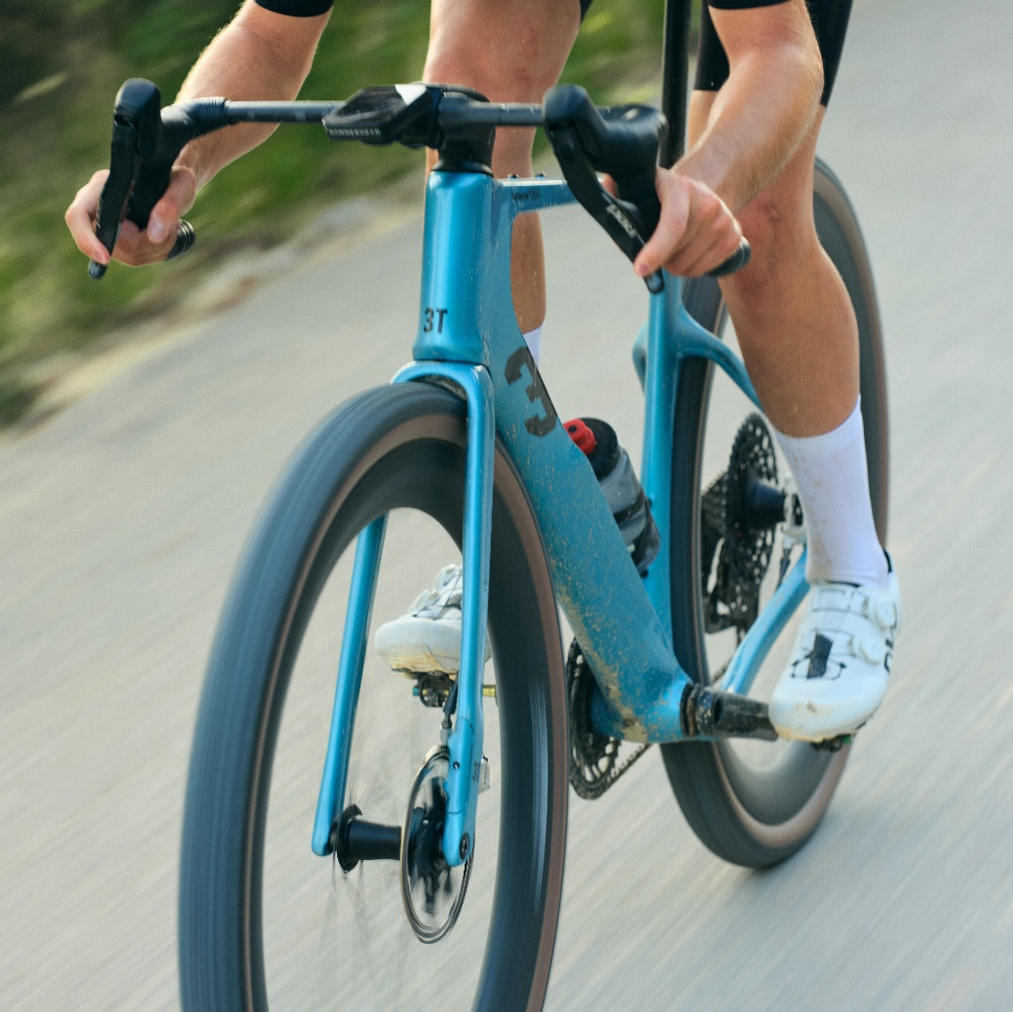

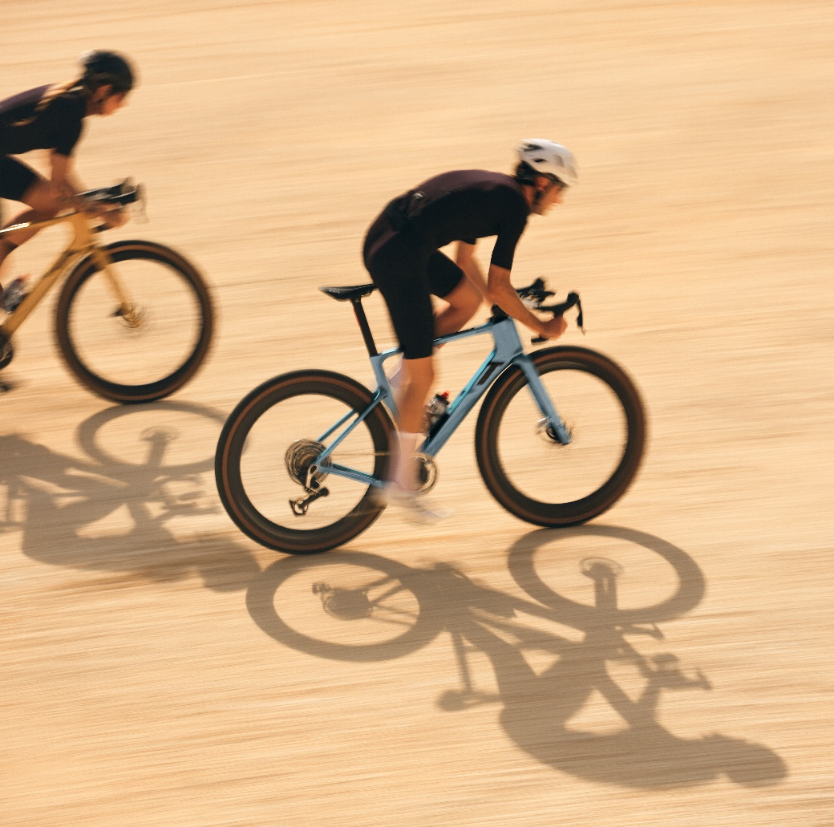
REALFAST GRAVEL GEOMETRY
Refined 3T REALFAST GRAVEL geometry. A comfortable yet efficient design.
Fast gravel optimized fit
Super fast handling
Improved stability
Reactive power transfer
To maximize performance
Steeper head angle
Increased BB drop and fork offset
Super short chainstays: 420 mm
3T.BIKE
Embargo until October 10th, 2025
RACEMAX - 4
Notes:
[no SRAM compatibility]

Slide 5
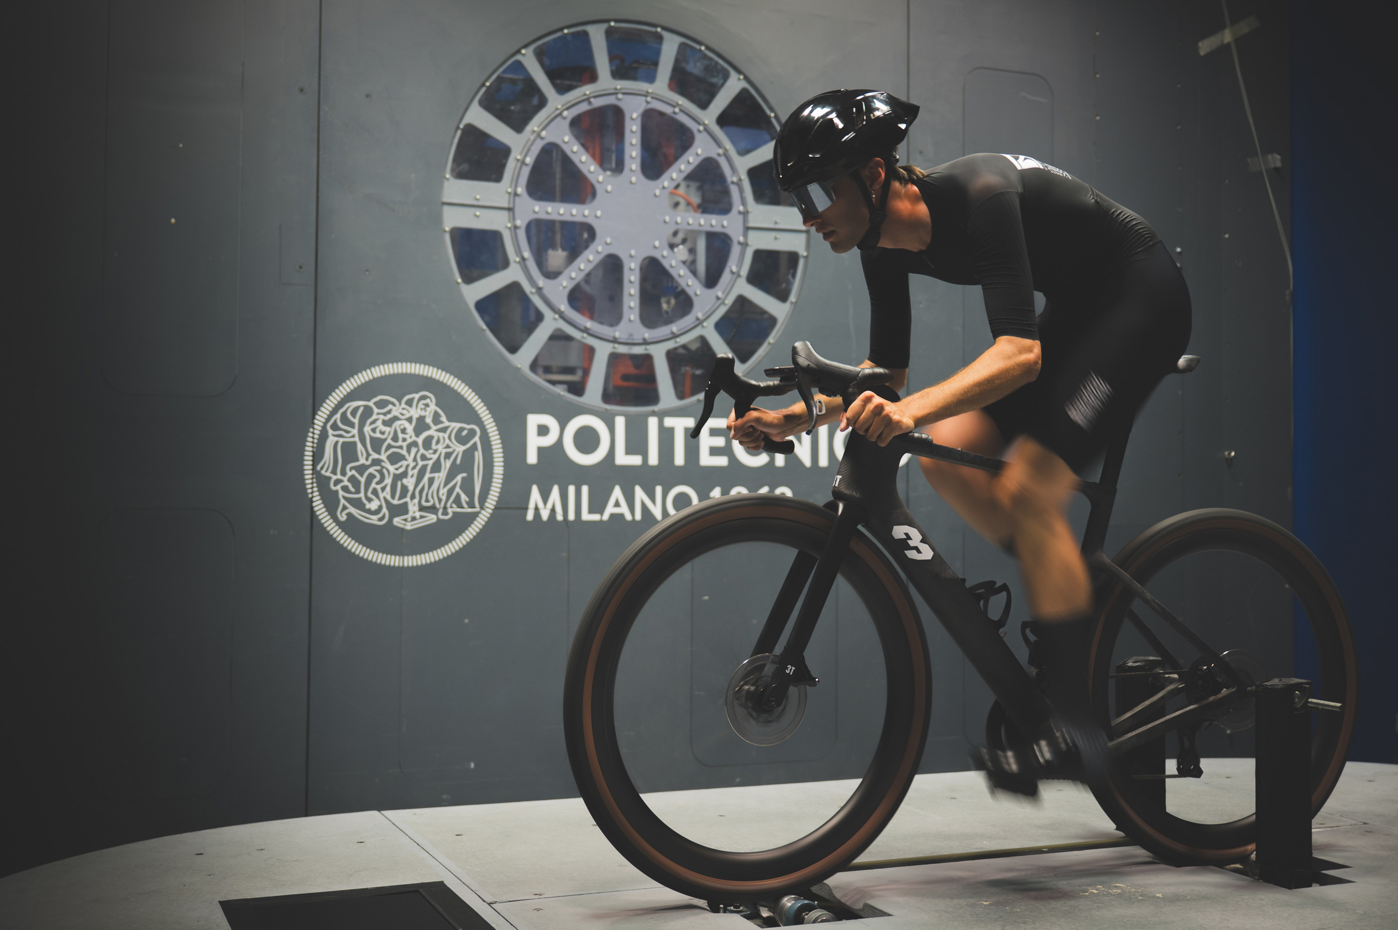
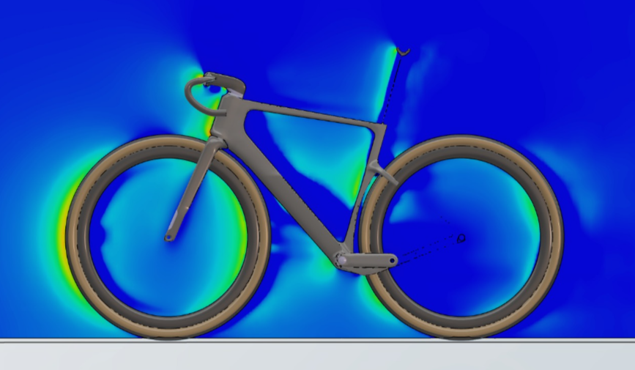
AERODYNAMICS
1.5% faster than the Racemax Italia
despite wider tires!
DRAG IN NEWTONS
Speed in km/h | Racemax² Italia | Racemax Italia
15 | 0,68 | 0,69
25 | 2,00 | 2,03
35 | 4,10 | 4,16
45 | 6,30 | 6,39
3T.BIKE
Embargo until October 10th, 2025
RACEMAX - 5
Notes:
[no SRAM compatibility]

Slide 6
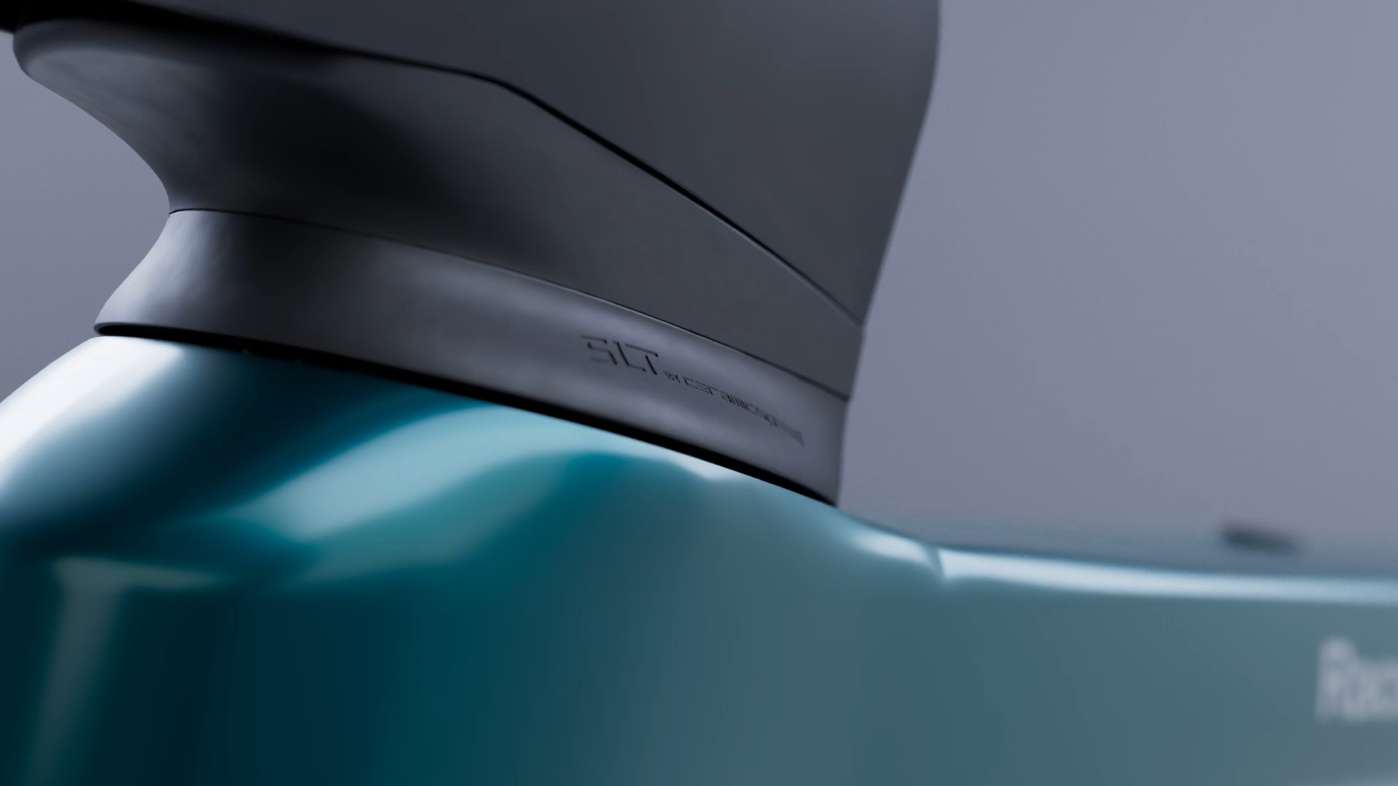

AERODYNAMICS – THE FRONT END
Narrow yet stiff headtube area
44/33 – 52/42
CeramicSpeed SLT
bearings inside
3T.BIKE
Embargo until October 10th, 2025
RACEMAX - 6
Notes:
[no SRAM compatibility]

Slide 7
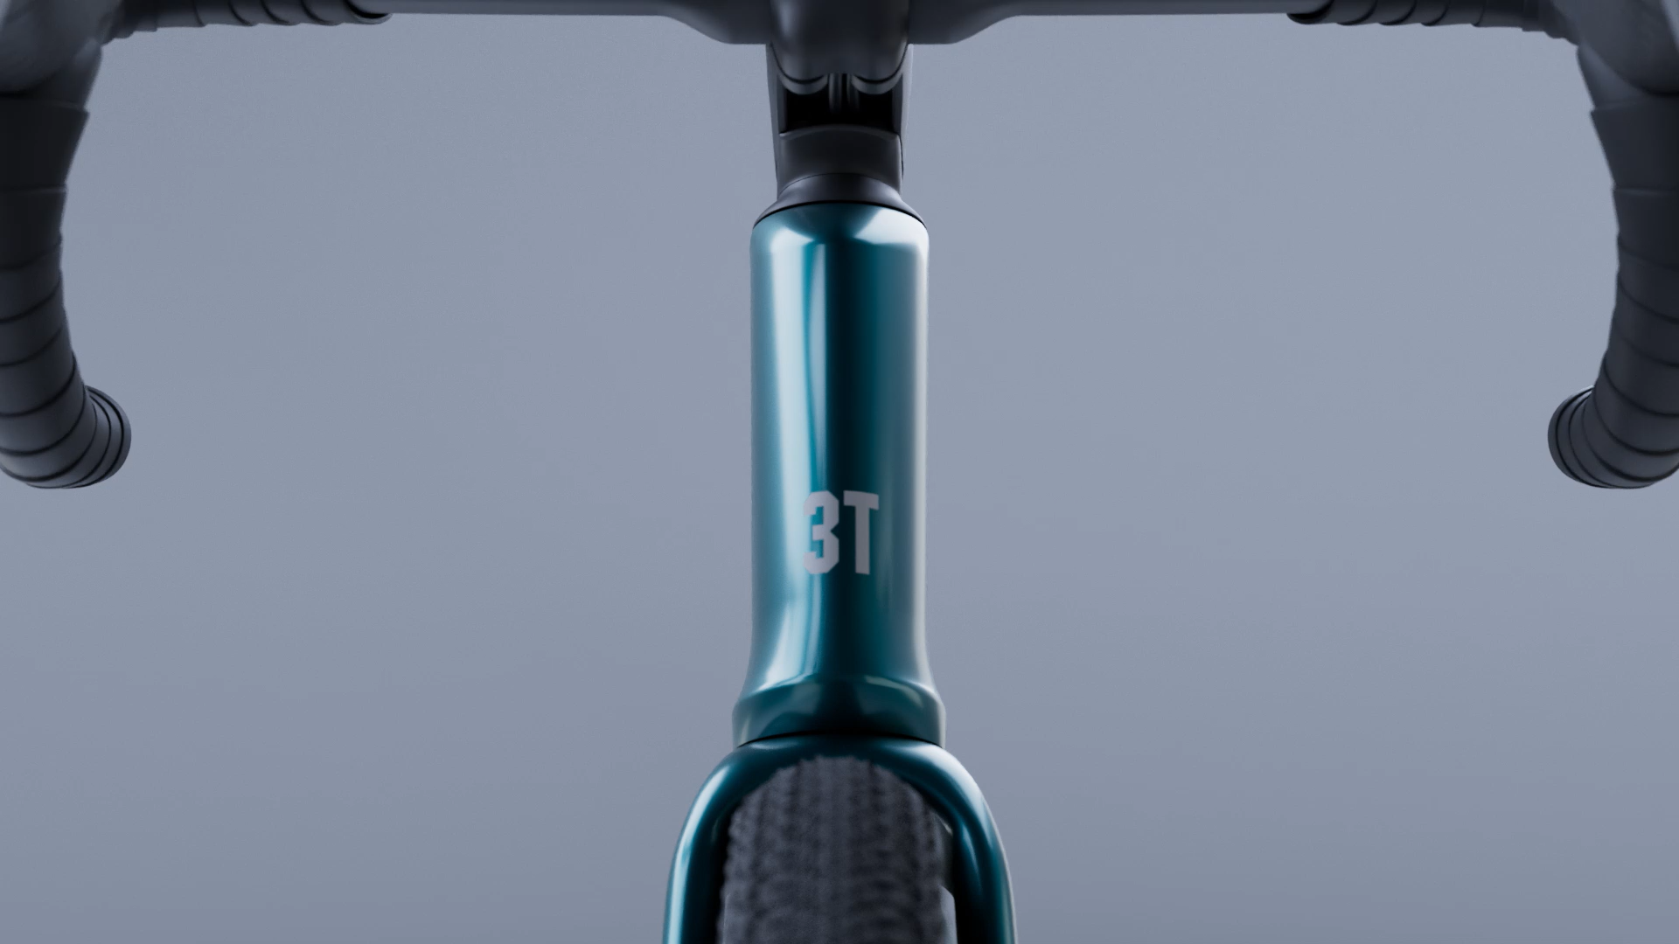
AERODYNAMICS – THE FRONT END
Front nose and elongated tail
Aero maximization
MINIMALIST FANGO RACEMAX² CROWN
Works in combination with the headset area.
Embargo until October 10th, 2025
RACEMAX - 7
Notes:
44/33 – 52/42 CeramicSpeed SLT bearings inside [ reliability

Slide 8
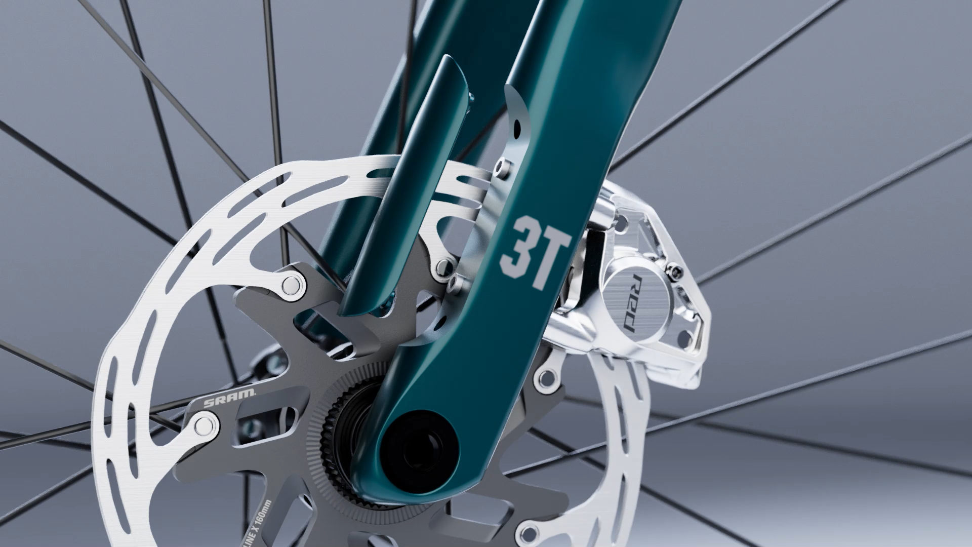
AERODYNAMICS – THE FRONT END
FANGO RACEMAX² fork aero features
Caliper bolt cover, no DS through axle hole
Embargo until October 10th, 2025
RACEMAX - 8
Notes:
44/33 – 52/42 CeramicSpeed SLT bearings inside [ reliability

Slide 9
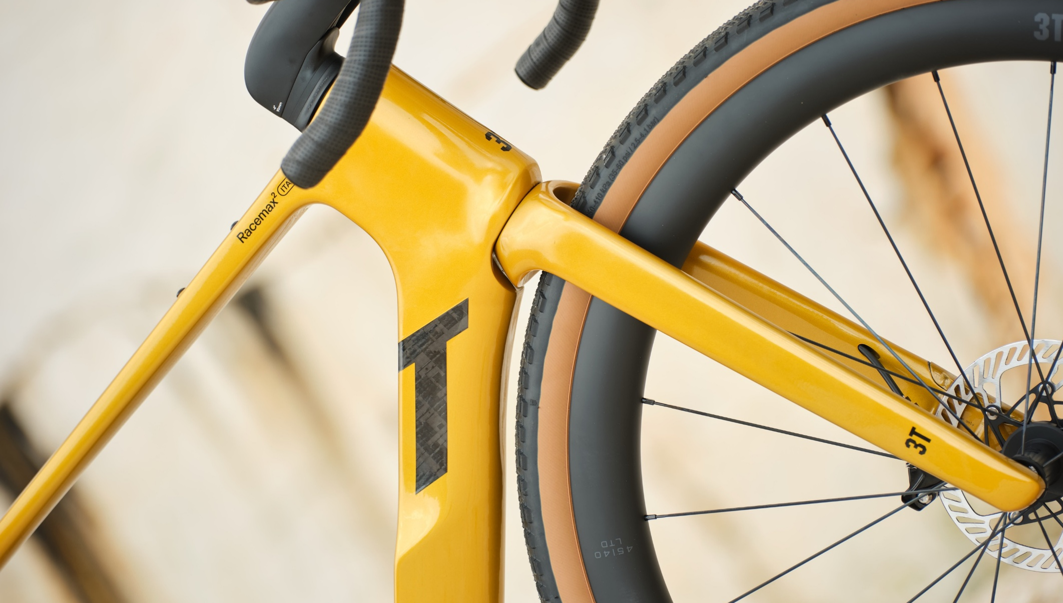
AERODYNAMICS – THE DOWNTUBE
54 MM NECK & FRONT WHEEL CUT-OUT
It works in combination with 41-51 mm WAM tires.
Embargo until October 10th, 2025
RACEMAX - 9
Notes:
Storage: possibility to put inside Co
: size- specific. designed to work in combination with the front end2, inner tube, levers

Slide 10
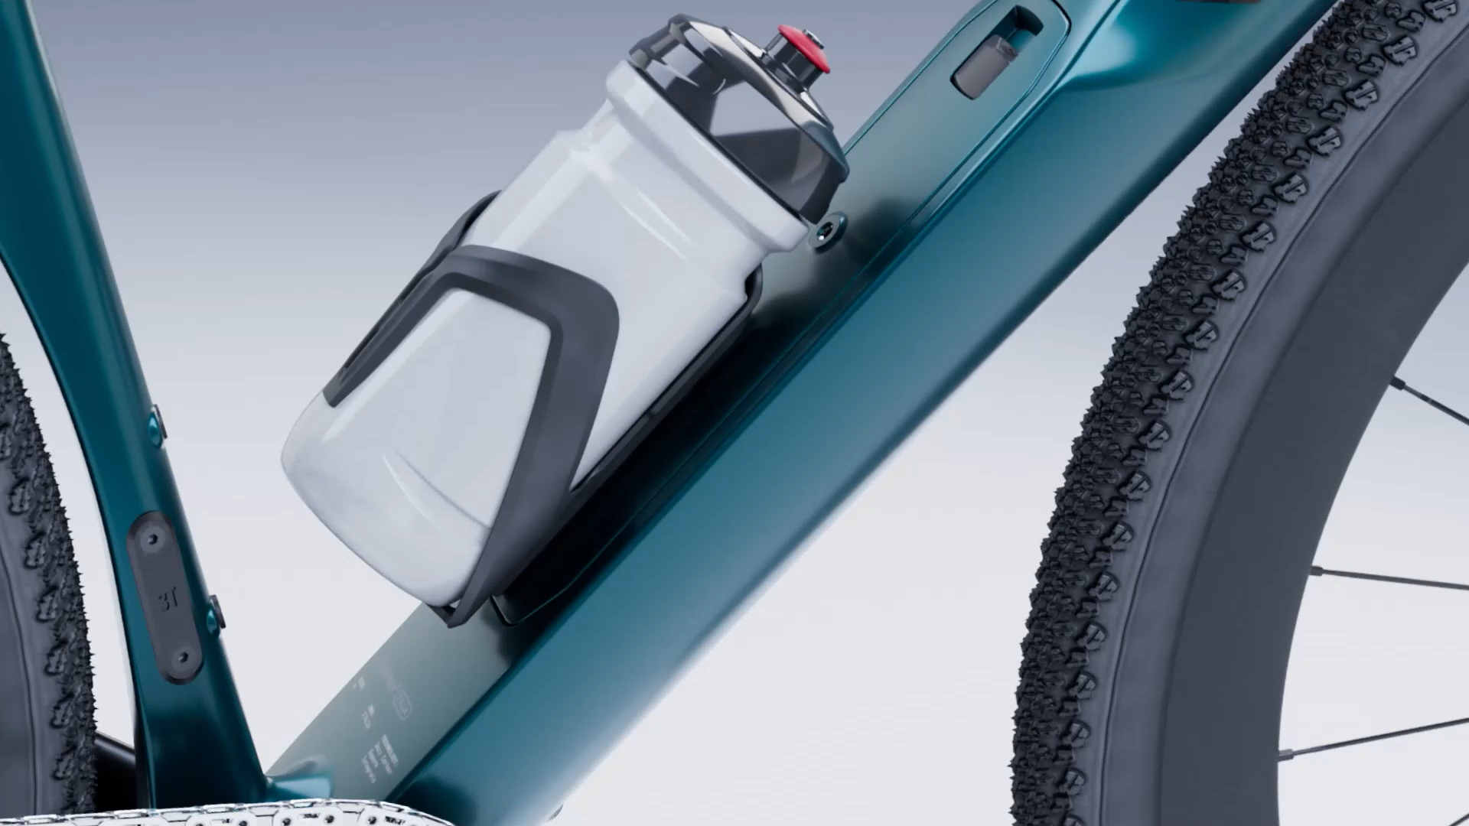
AERODYNAMICS – THE DOWNTUBE
75 MM DOWNTUBE BODY
Bottle shielding effect
Embargo until October 10th, 2025
RACEMAX - 10
Notes:
44/33 – 52/42 CeramicSpeed SLT bearings inside [ reliability

Slide 11
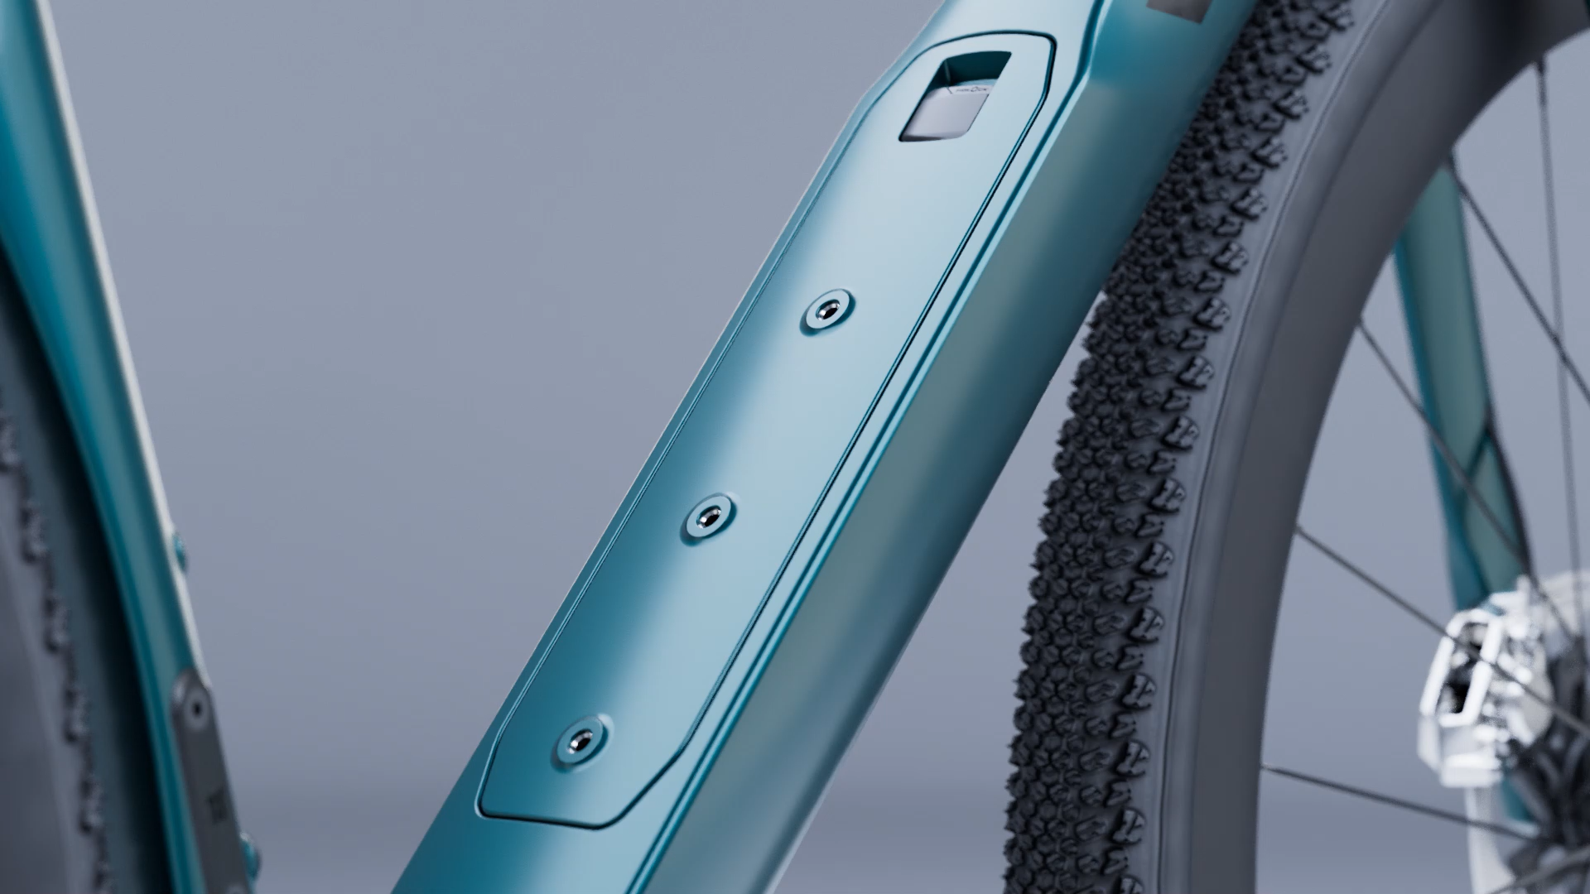
AERODYNAMICS – THE DOWNTUBE
Storage integration
It hides repair kit: cleaner and more aero.
It allows for 2 positions of downtube bottle.
Embargo until October 10th, 2025
RACEMAX - 11
Notes:
44/33 – 52/42 CeramicSpeed SLT bearings inside [ reliability

Slide 12
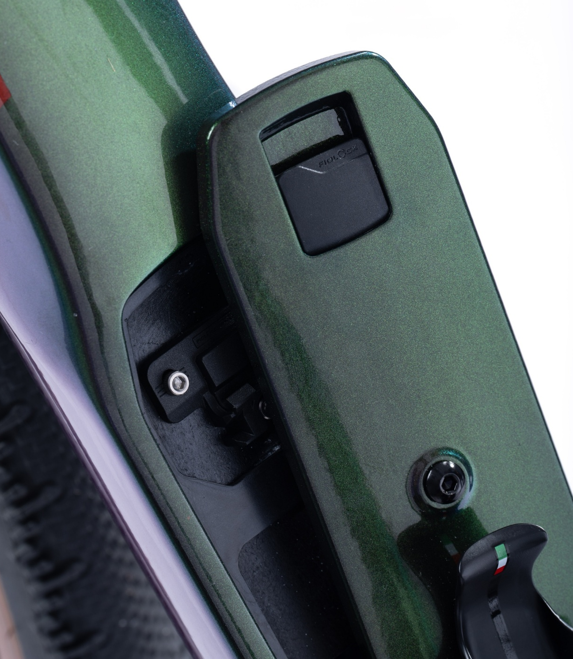
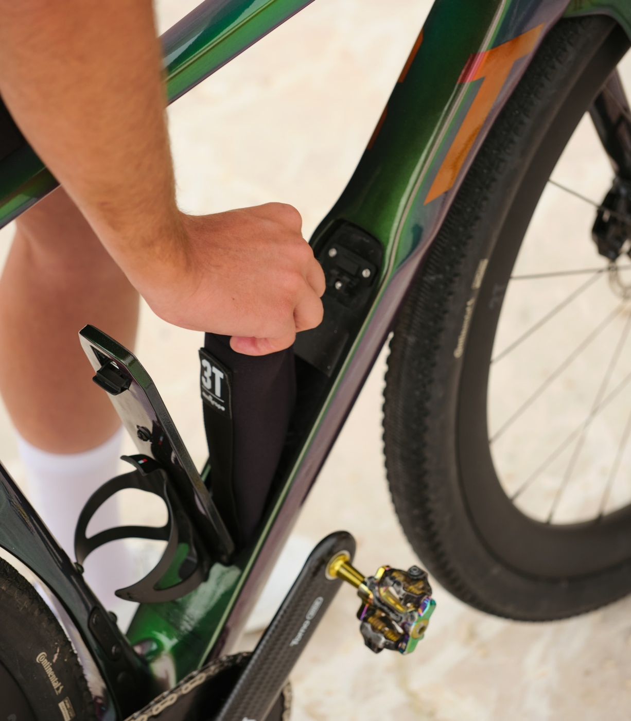
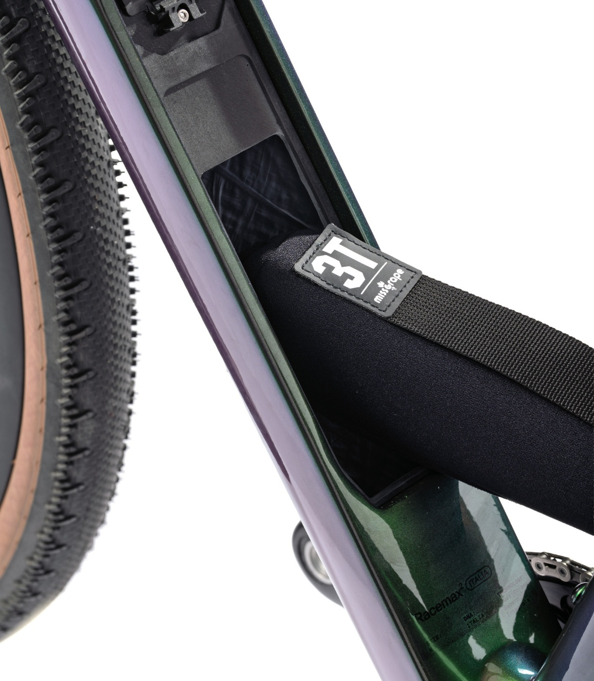
STORAGE
Fidlock®
mini-hook closure
Easy to access
Dedicateg bag
Easy to open, Safe lock.
Plenty of space
Made by Missgrape for 3T
3T.BIKE
Embargo until October 10th, 2025
RACEMAX - 12
Notes:
[no SRAM compatibility]

Slide 13
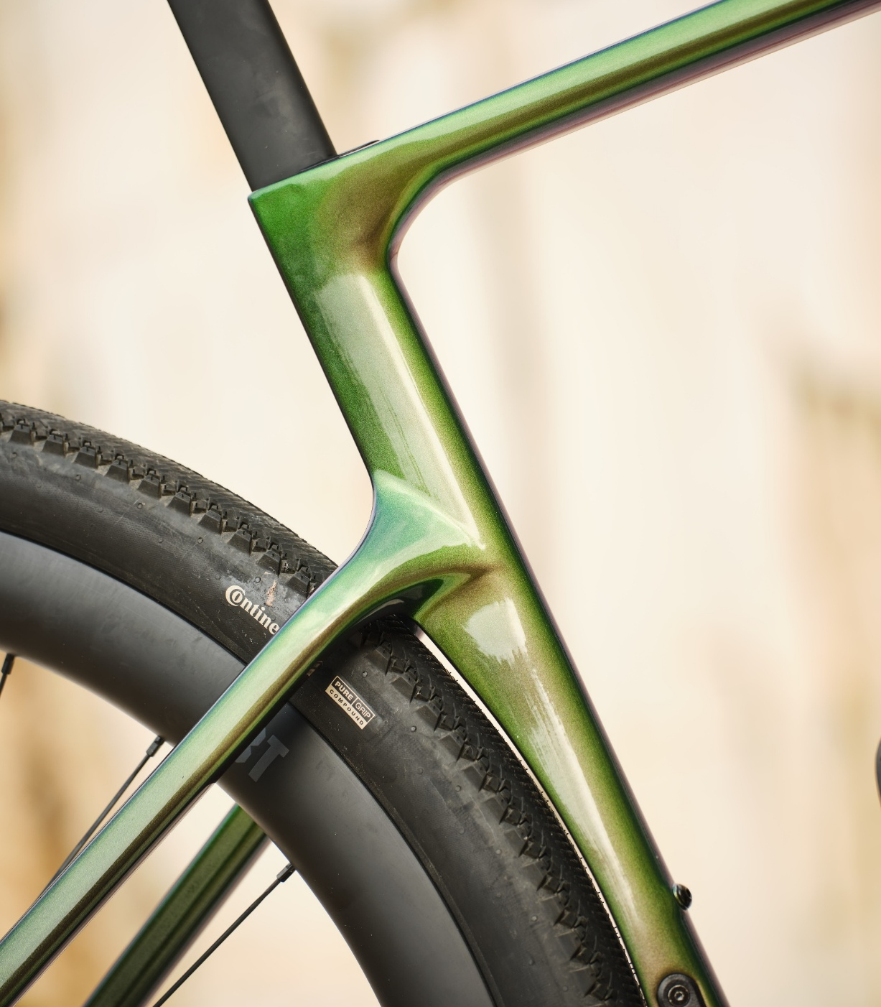
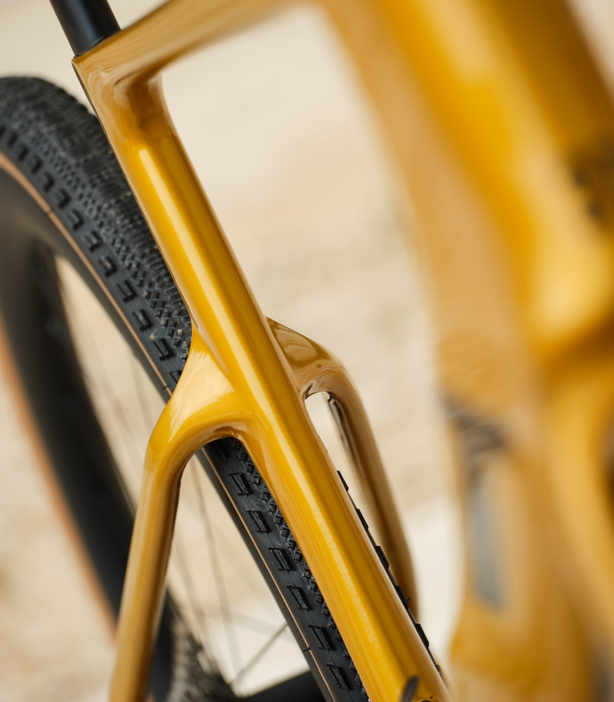
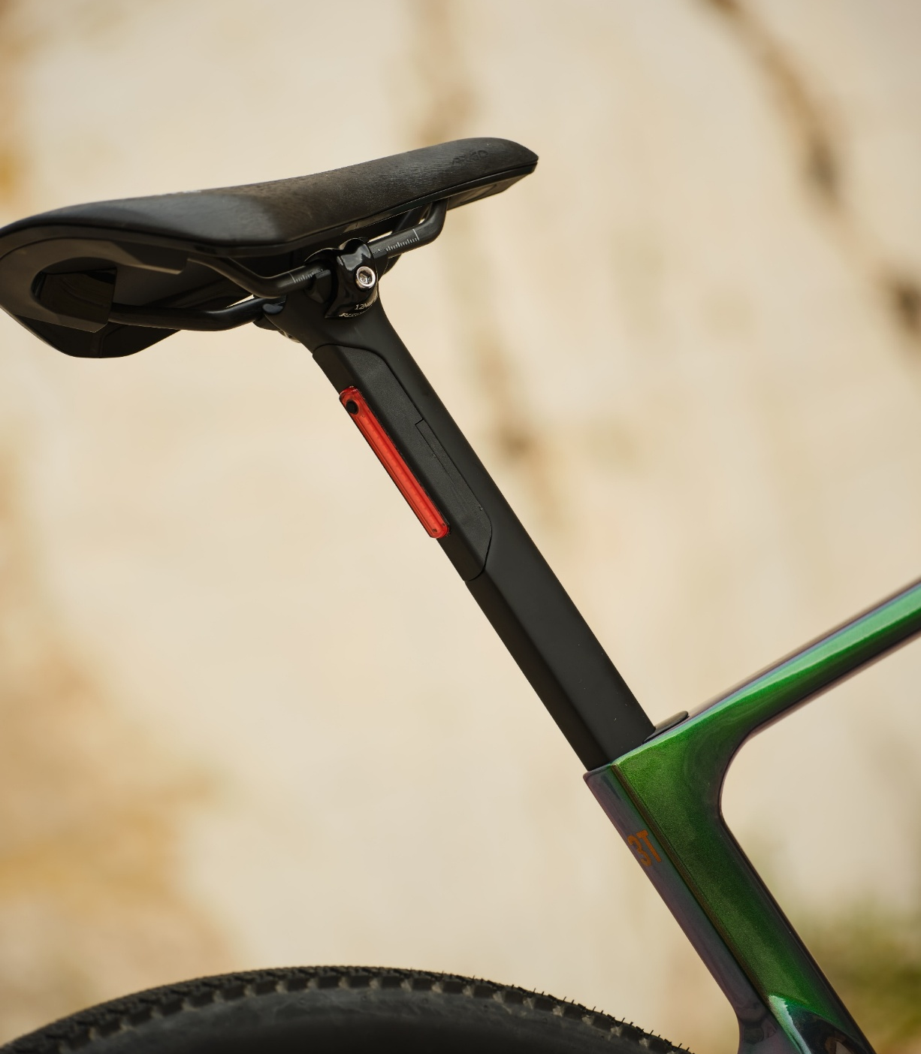
AERODYNAMICS – REAR END
Rear wheel cut-out
Fully aero seatstays and seattube junction
Seat tube
Increased clearance and aerodynamics
It maintains reactiveness and comfort
Aero, light integration
Embargo until October 10th, 2025
RACEMAX - 13

Slide 14
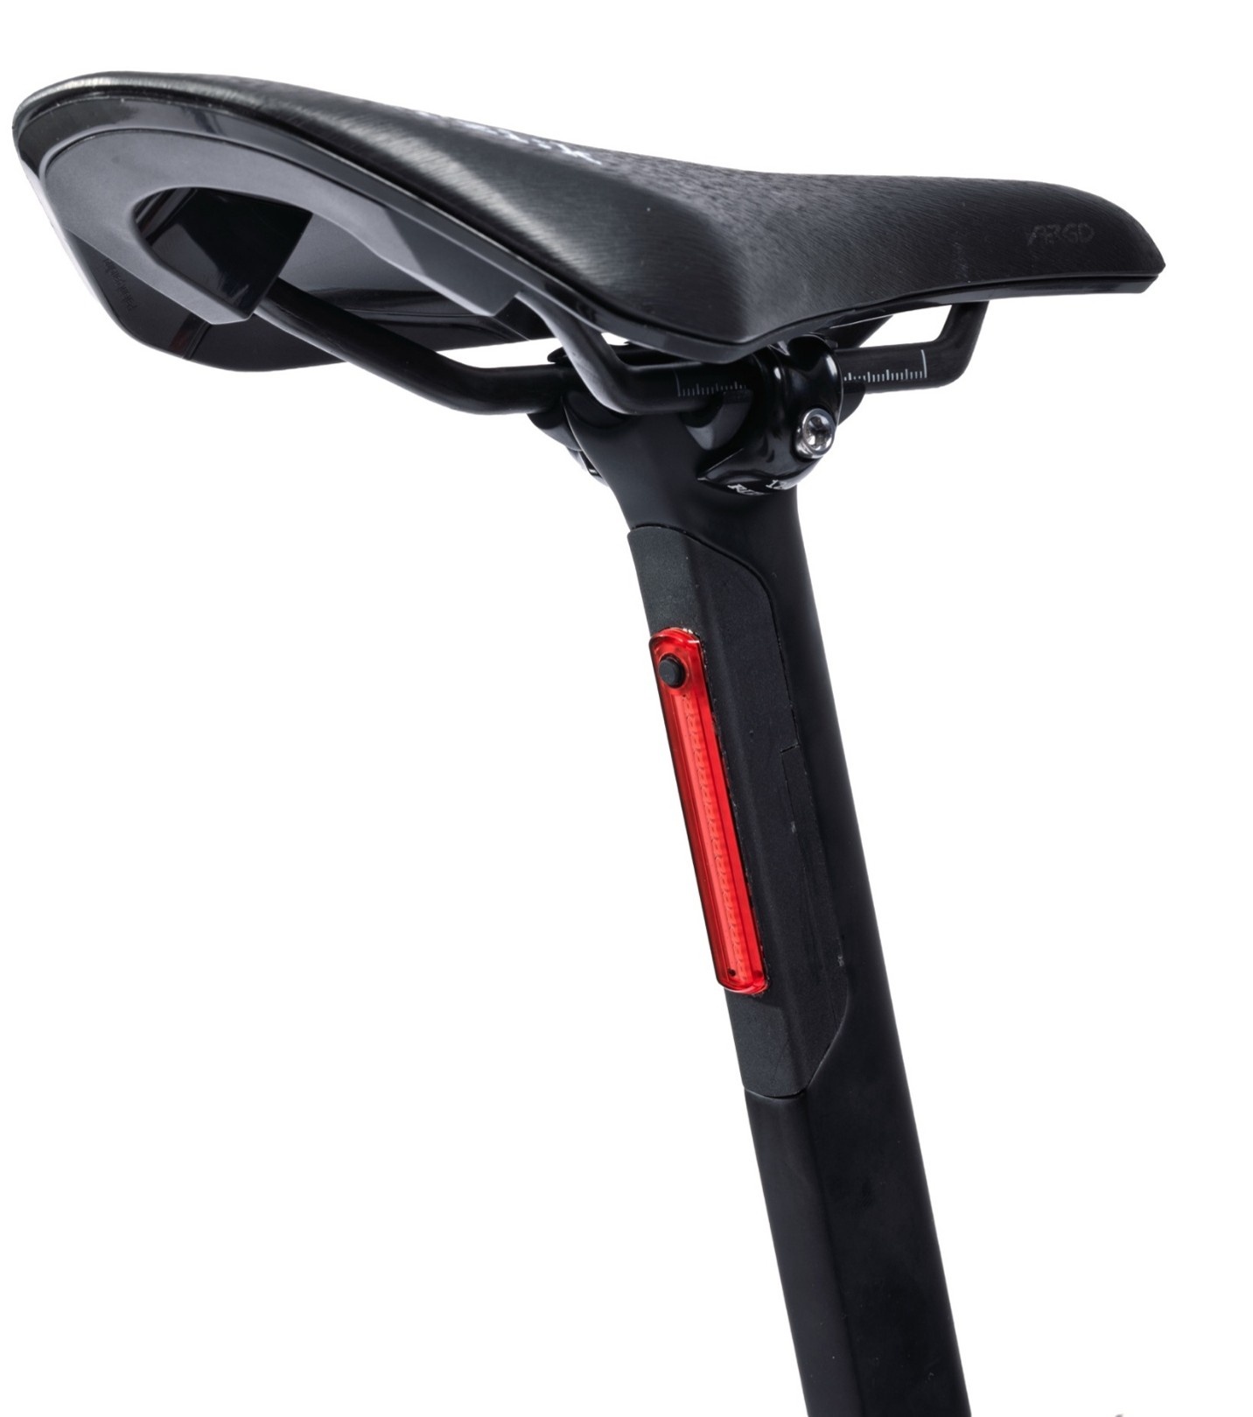
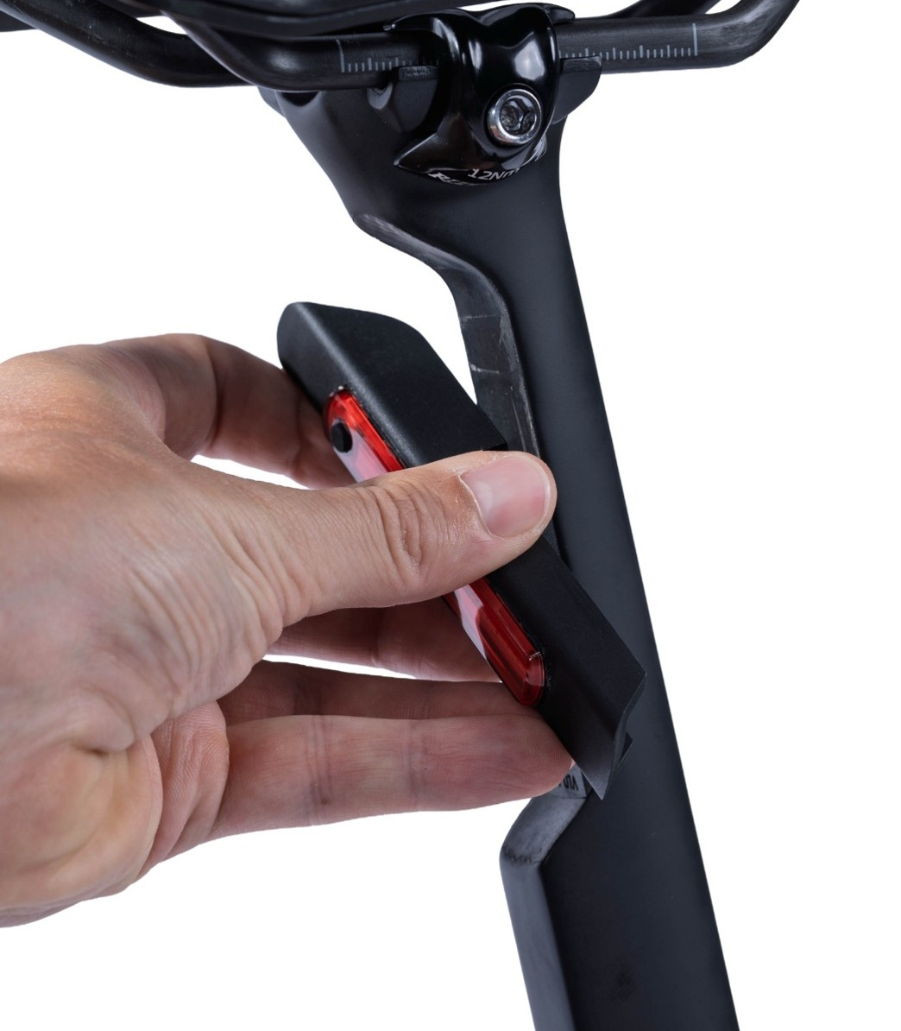
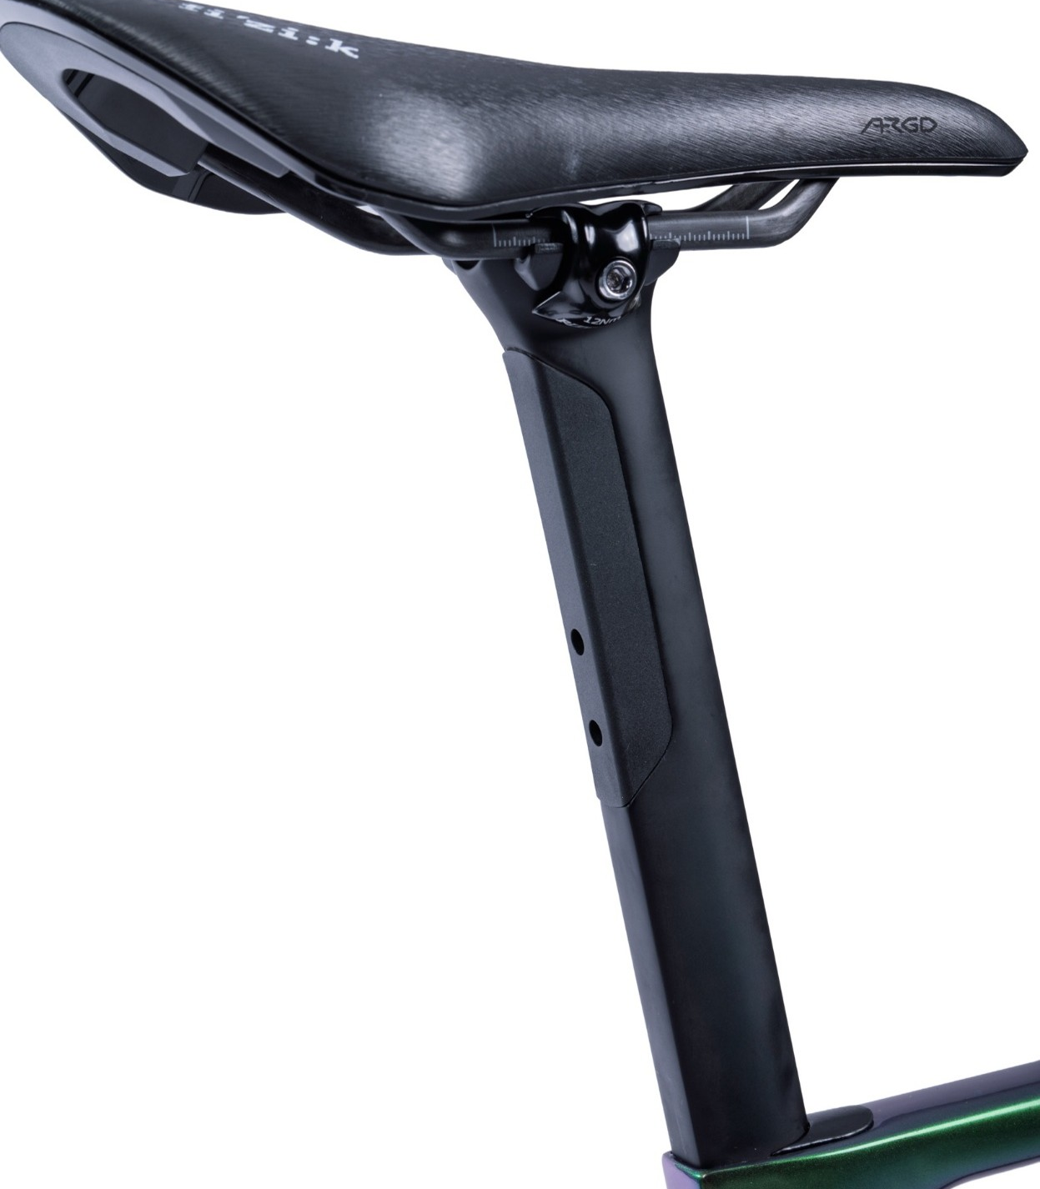
LIGHT INTEGRATION
Light specs
Easy to remove
Full Cover
Up to 25 lumens
5 modes
… and charge!
For bikepacking
3T.BIKE
Embargo until October 10th, 2025
RACEMAX - 14
Notes:
[no SRAM compatibility]

Slide 15
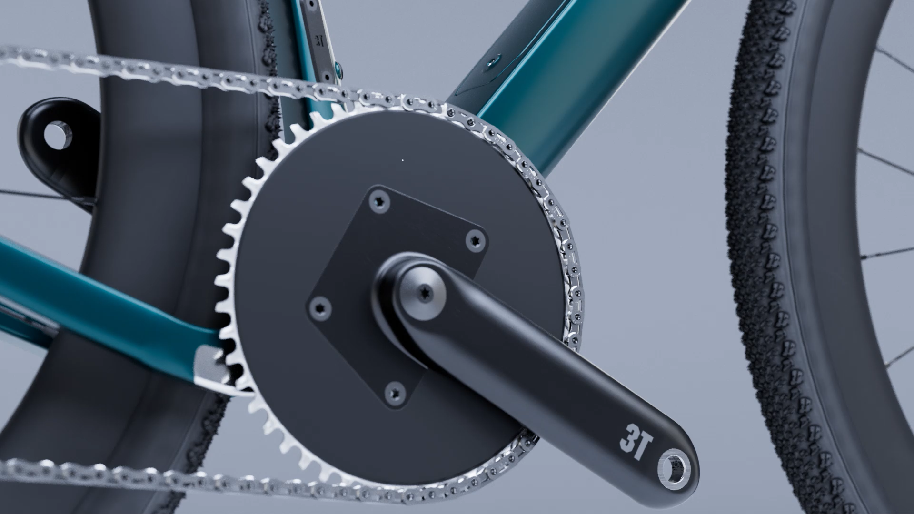
AERODYNAMICS – THE DOWNTUBE
1x drivetrain
up to 52T w/
Torno Wide crank
2x drivetrain
GRX 2x12 48/31
Campagnolo 2x13 52/36
Embargo until October 10th, 2025
RACEMAX - 15

Slide 16

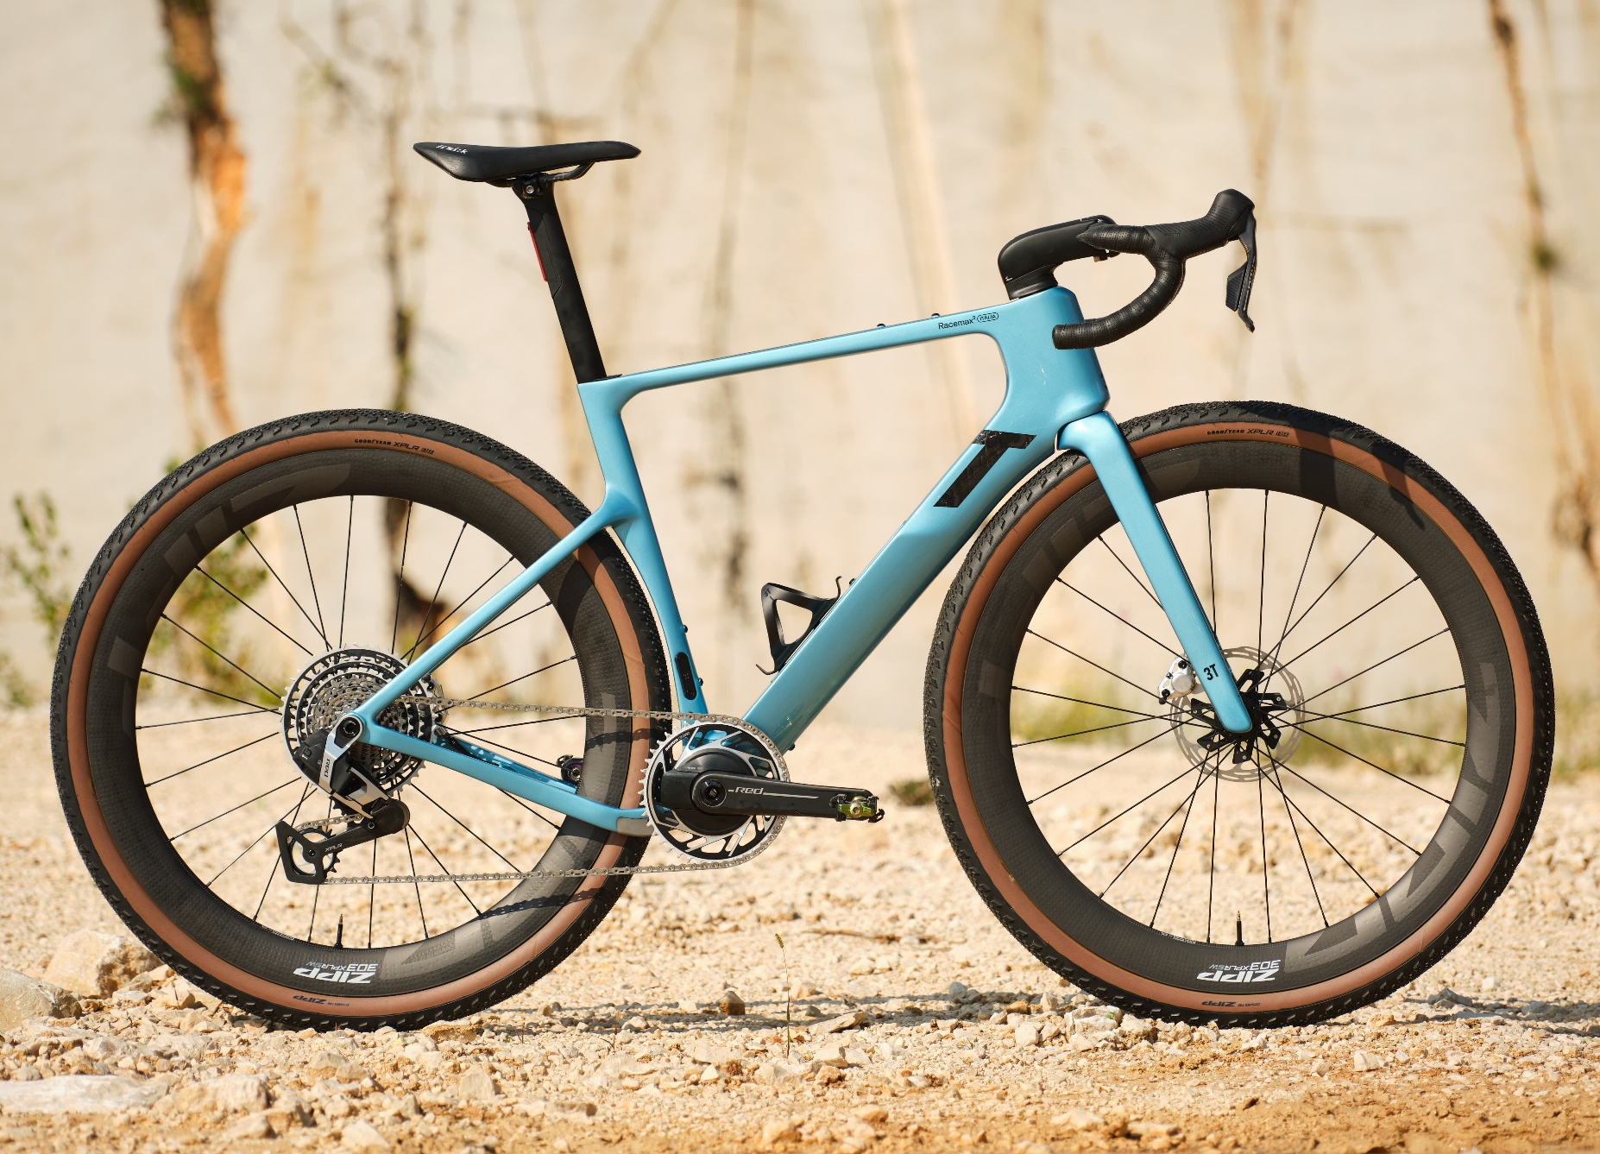
WEIGHT
FORK
380 g
FRAME
990 g (no storage)
1050 g (storage)
COMPLETE BIKE
from 7,90 kg
size M, unpainted, without hardware and small parts
+/- 5%
Embargo until October 10th, 2025
RACEMAX - 16
Notes:
[recommended] Tire range 35 - 45mm WAM

Slide 17
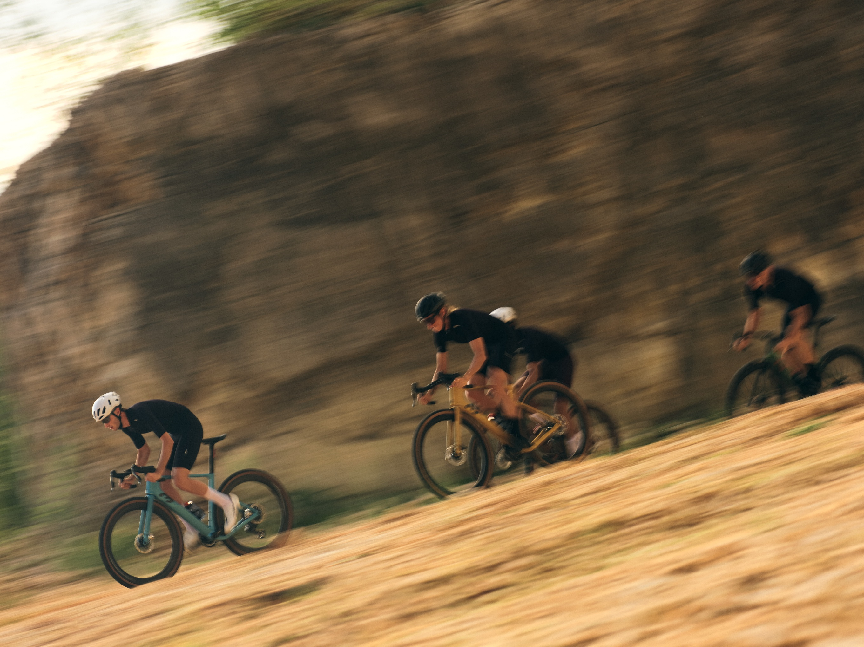
BIKE PROFILE
RIDER PROFILE
Gravel racer chasing speed and performance on every ride.
DESIGNED FOR
Races and rides where every watt counts and the scenery is only noticed when watching the recap.
MSRP (ex-VAT)
Frameset: 4.917 €
Complete bike: from 8.115 to 10.736 €
SIZES
4: S, M, L, XL
Embargo until October 10th, 2025
RACEMAX - 17
Notes:
[recommended] Tire range 35 - 45mm WAM

Slide 18
3T BIKES SIZING
Starting from October 1st, every 3T bike (and frame) SIZE will be expressed in LETTERS and no longer with numbers.
48 | → | XS
51 | → | S
54 | → | M
56 | → | L
58 | → | XL
61 | → | XXL
RACEMAX - 18

Slide 19

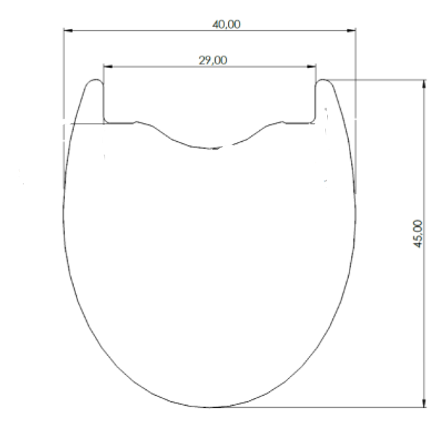
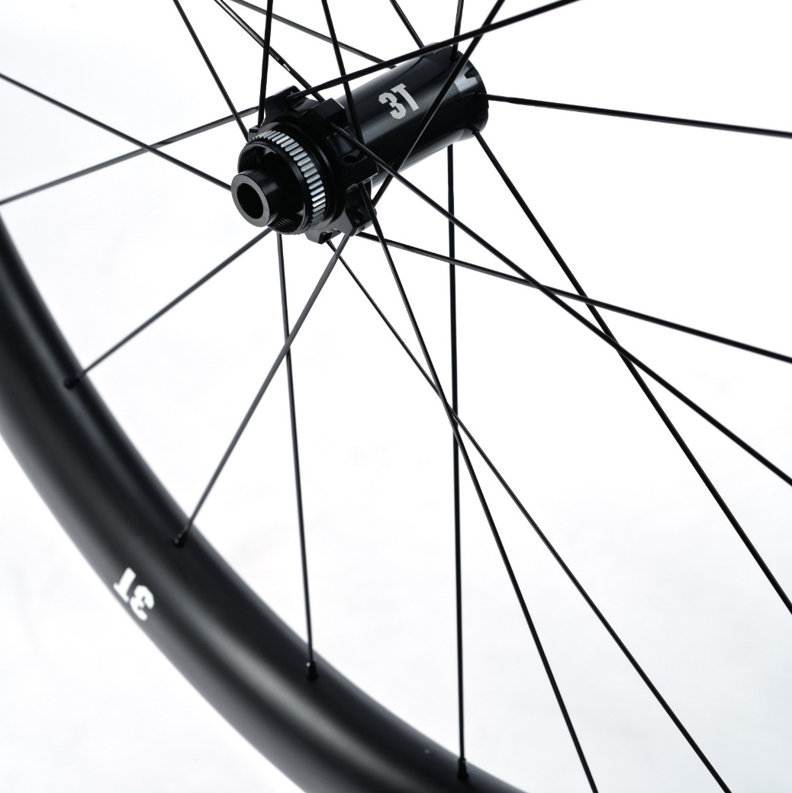
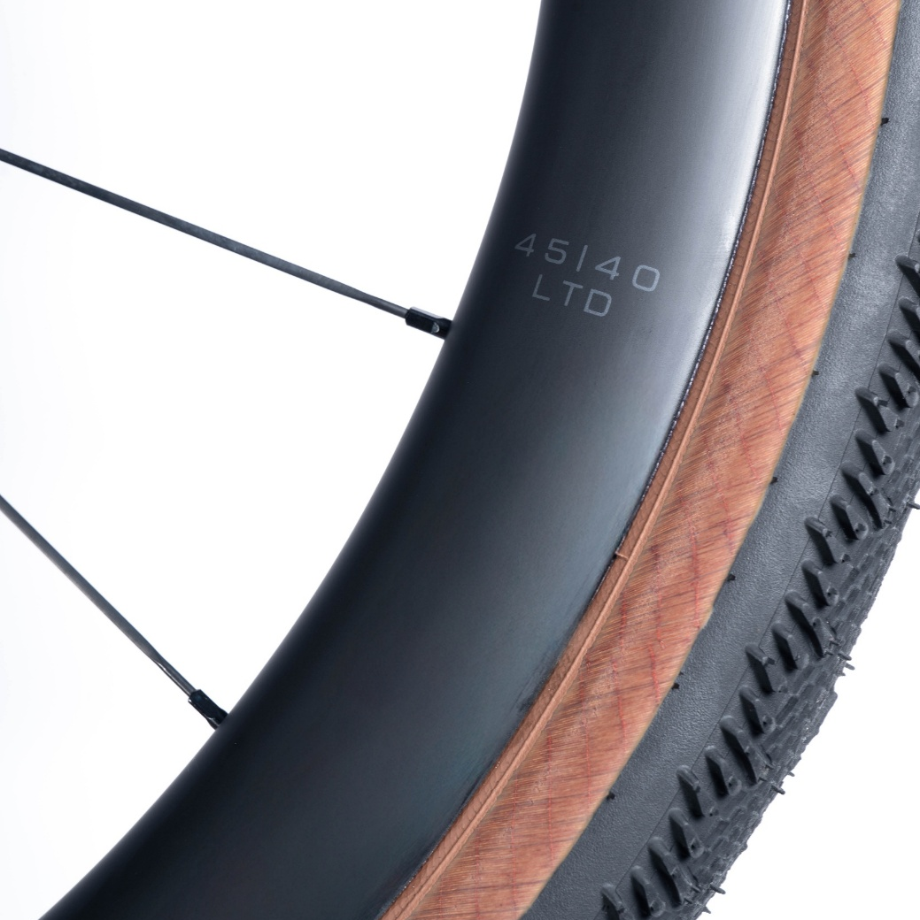
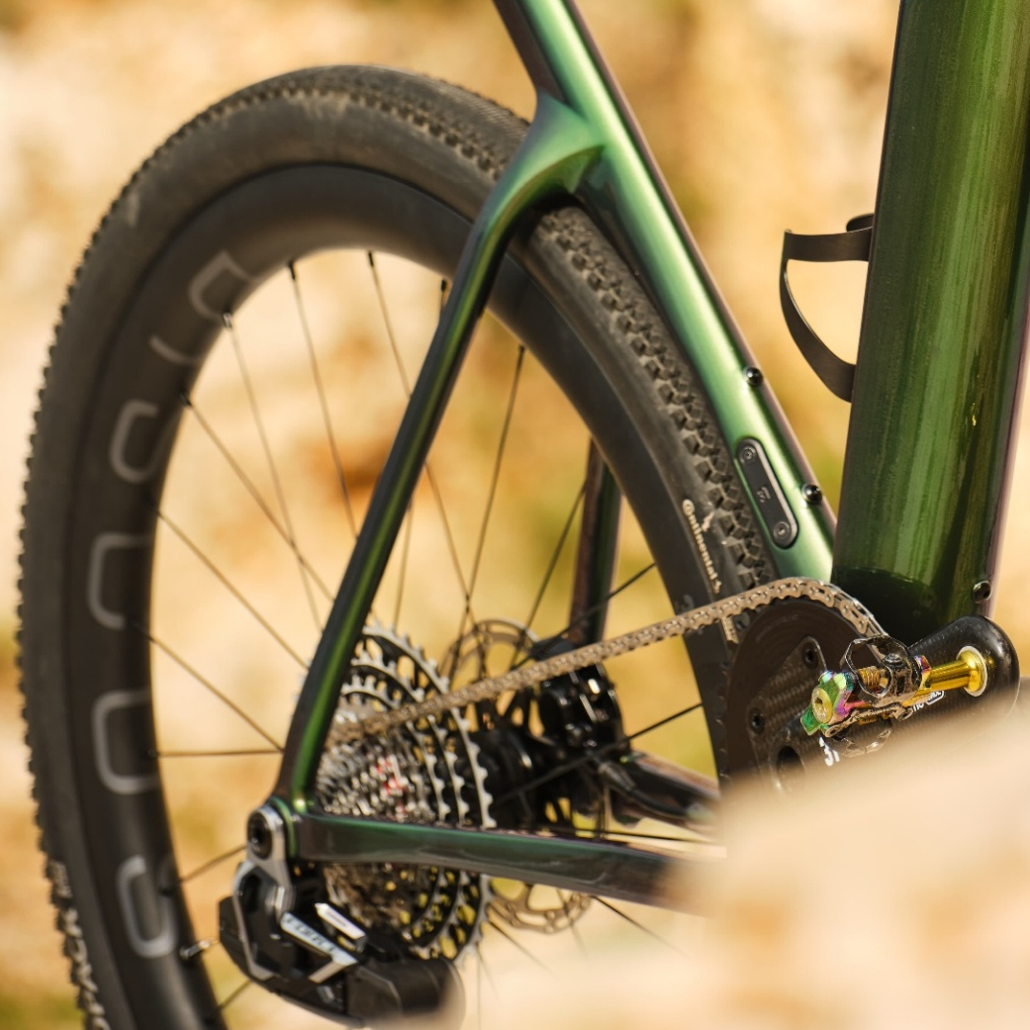
Comfortable yet reactive, enhances aerodynamics and fit of 40-60 mm WAM tire.
29 mm inner width 45 mm deep
40mm wide
Scope Race series hubs
Sapim Cx-ray
1.435 g
1.720 €
Hookless
Min. 40mm – Max 60mm tires
21 spokes front, 24 rear
weight
MSRP (ex-VAT)
From November
Embargo until October 10th, 2025
DISCUS - 19
Notes:
completely re-engineered frame for an even better all-round experience: faster, more responsive, more agile yet more stable, with improved comfort and refined design. Added to this is the next level of integration

Slide 20
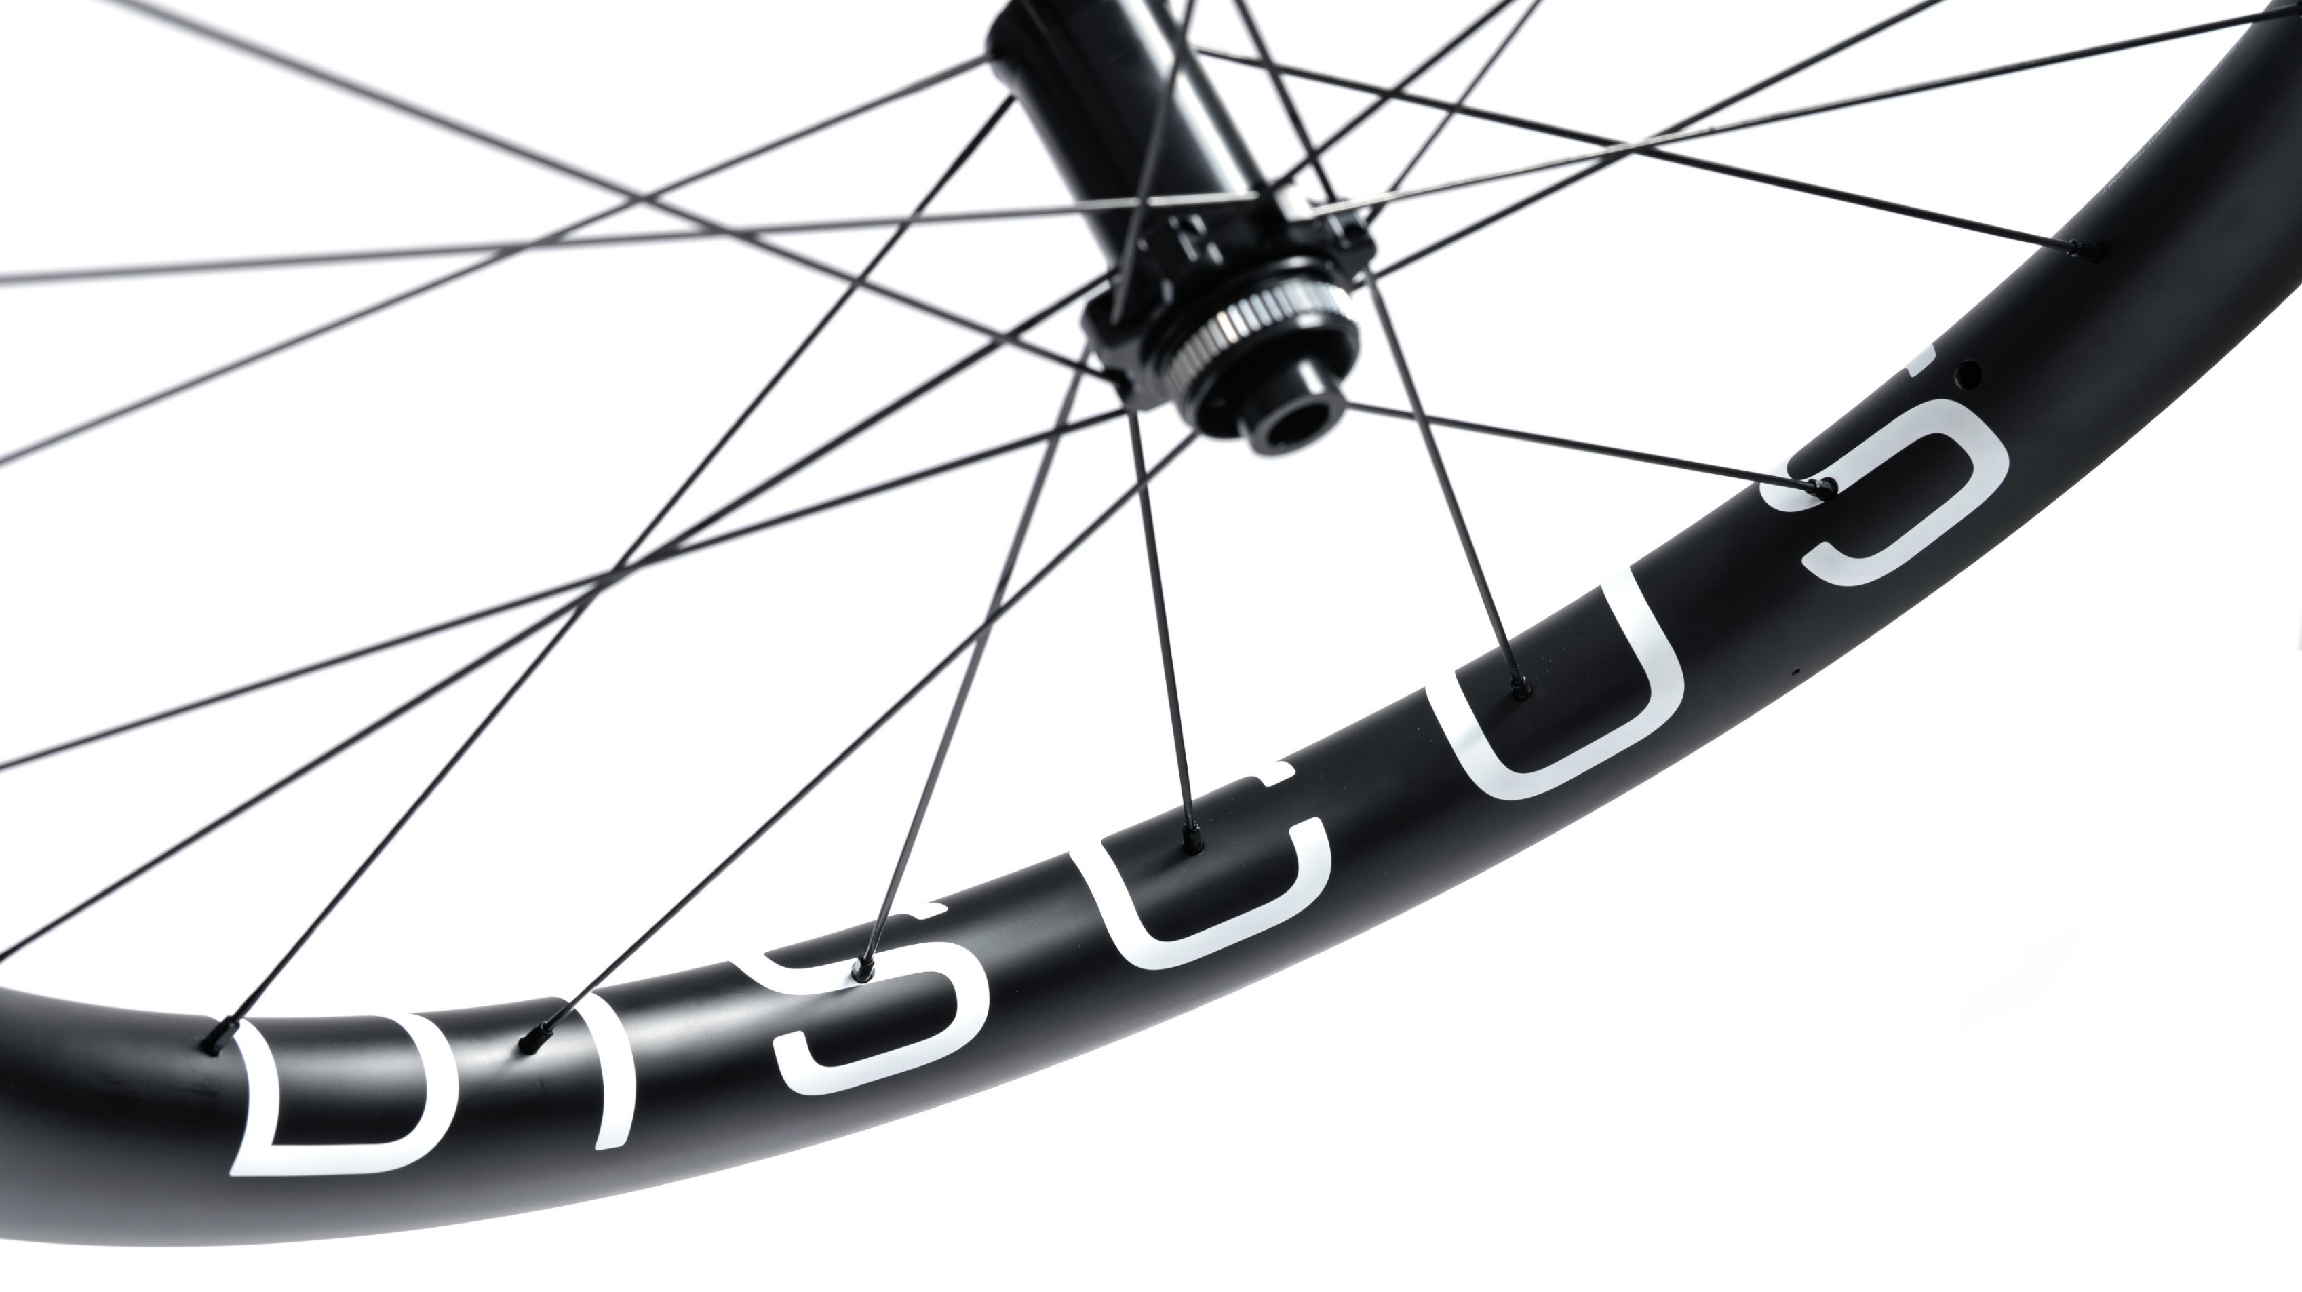
THE NEW DISCUS FAMILY GRAPHICS
Embargo until October 10th, 2025
DISCUS - 20
Notes:
Storage: possibility to put inside Co
: size- specific. designed to work in combination with the front end2, inner tube, levers

